Slide 1
How to Ace Project Viva?
REVA Academy for Corporate Excellence (RACE)
By,
RACE Program Office
March 2023
race.reva.edu.in

Slide 2
Discussion Points
Pre-requisites
Marks allocation
Slide Deck -Best Practices
How to plan the demo
Defending your thesis/project
A few tips to ace the viva

Slide 3
Pre-requisites
Thesis/Report
Slide Deck
Demo/Code/ Datasets/Git
Plagiarism report
Confidence!
☺

Slide 4
Tell a Story!
Deck Plan
Title Slide
Agenda
Introduction (~2)
Literature Review (2)
Problem Statement (1)
Objectives of the Study (1)
Project Methodology (1)
Software Design
Implementation (demo)
Testing and Validation ((~2)
Analysis and Results (~2)
Conclusion (1)

Slide 5
Preparing your Deck
Deck Plan
Title Slide
Agenda
Introduction (~2)
Literature Review (2)
Problem Statement (1)
Objectives of the Study (1)
Project Methodology (1)
Software Design
Implementation (demo)
Testing and Validation ((~2)
Analysis and Results (~2)
Conclusion (1)
Well-designed PPT as per the template
Maximum 12-15 Slides for a 20 minutes presentation
Appropriate usage of images with short descriptions
Use bullet points
PPT must speak by itself (without you!)
Do not use PPT as a Word doc!
Be Brief, Crisp and Professional
Use mild colours
Tell a cohesive story!
Refer to best practices on making PPTs from consulting firms

Slide 6
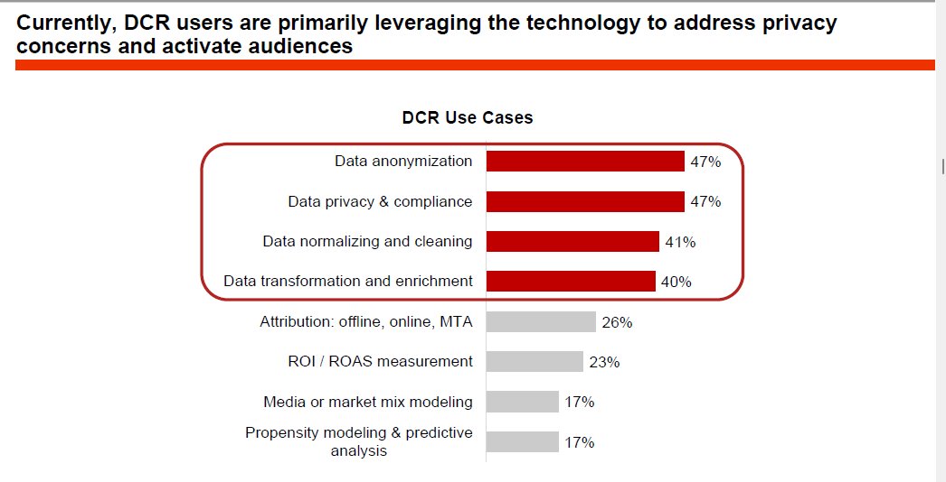

Slide 7
Best Practices on Presentations
General Tips
https://cubicleninjas.com/top-20-best-powerpoint-presentation-design/
McKinsey presentations –Live
https://www.youtube.com/watch?v=MbwFt8wWilU

Slide 8
Viva-Voce – Cybersecurity
Description | Marks
Topic, Literature Review and Methodology | 20
Project Implementation | 25
Presentation and Defense | 25
Project Report | 30
Capstone Mentoring | +25
30 minutes with Q&A
Industry mentors as Panellists

Slide 9
Viva-Voce – Business Analytics
Description | Marks
Business Understanding | 15
Data Preparation and EDA | 15
Modeling and Results | 20
Project Report | 30
Presentation and Defense | 20
Mentoring Process | 25
30 minutes with Q&A
Industry mentors as Panellists

Slide 10
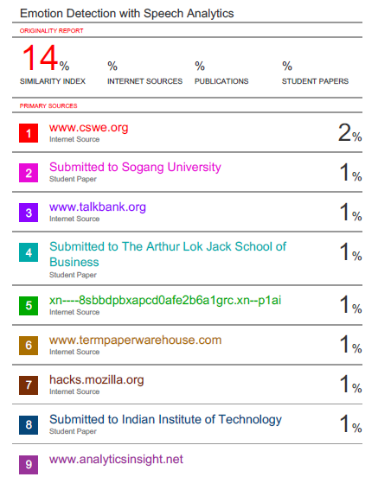
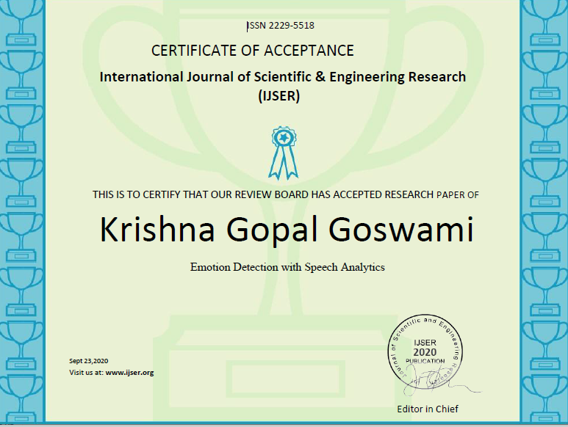
Appendix – To attach
Plagiarism Report – Cover page and last pages
Publication Details
Full paper
Acceptance Letter
GitHub Link/Script

Slide 11
Acing Viva?
Before Viva
Dress formal
Greet
Introduce yourself and the topic
Plan the timing
Professional PPT
PRACTICE!
During Viva
Explain the Agenda
Be Aware of the Concepts
Demonstration of the Project
Q & A
Do not Fake!

Slide 12
All The Best!

